Slide 1

Starter Question
How many stars are there?
1100
12
14
C
Notes:
The primary source for the material in this presentation (including figures and illustrations) is The Architecture of Computer Hardware, Systems Software, & Networking: An Information Technology Approach, 4th edition (plus supplementary materials) by Irv Englander (John Wiley & Sons, 2009).

Slide 2
Starter question with Base numbers
How many stars are there?
1100₂
12₁₀
14₈
C₁₆
All of the above are valid representations

Slide 3
Binary Addition
0 + 0 = ? 0 + 1 = ? 1 + 0 = ? 1 + 1 = ?

Slide 4
Binary Addition
0 + 0 = 0 0 + 1 = 1 1 + 0 = 1 1 + 1 = 10

Slide 5
Addition basics
Decimal
Binary
 | 1
+ | 1
 | 2
 | 4
+ | 5
 | 9
 | 7
+ | 5
 | 12
 | 0
+ | 0
 | 0
 | 0
+ | 1
 | 1
 | 1
+ | 0
 | 1
 | 1
+ | 1
 | 10
 | 1 | 1 | 1 |  |  | 1 | 1
 |  | 1 | 0 | 1 | 1 | 0 | 0 | 1
+ |  |  | 1 | 1 | 0 | 0 | 1 | 1
 | 1 | 0 | 0 | 0 | 1 | 1 | 0 | 0
 | 89
+ | 51
140

Slide 6
Binary Addition Algorithm
Binary addition algorithm is a bit-pattern manipulation procedure that is built into the hardware of computers
Start by adding 1-bit integers.
The bit at the top of the column is called the "carry into the column". The operation produces a two-bit result.
The left bit of the result is called the "carry out of the column".

Slide 7
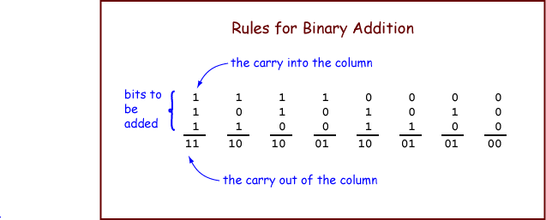

Slide 8
N-bit Binary Addition Algorithm
The algorithm takes two operands and produces one result. An operand is the data that an algorithm operates on.
To add two N-bit (representations of) integers: Proceed from right-to-left, column-by-column, until you reach the left-most column.
For each column, perform 1-bit addition. Write the carry-out of each column above the column to its left. The bit is the left column's carry-in.

Slide 9
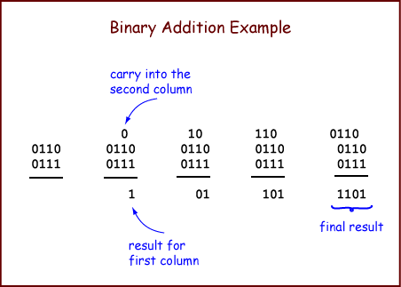

Slide 10
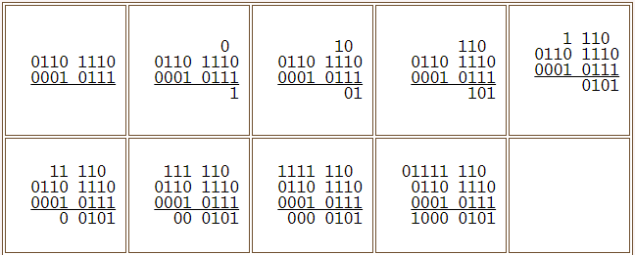
Larger Example

Slide 11
Larger Example
01111 110 0110 1110 = 110 (base 10) + 0001 0111 = 23 (base 10) 1000 0101 = 133 (base 10)

Slide 12
Overflow
1111 0111 1001 0000
Usually the operands and the result have a fixed number of bits (usually 8, 16, 32, or 64).
Two four-bit numbers are added, but the sum does not fit in four bits. If we were using five bits the sum would be 1 0000. But with four bits there is no room for the left-most "1".
Because the carry out from the most significant column of the sum is "1", the 4-bit result is not valid.

Slide 13
Multiplication basics
Decimal
Binary
 | 12
x | 0
 | 0
 | 12
x | 1
 | 12
 | 12
x | 2
 | 24
 | 12
x | 10
 | 120
 | 0
x | 0
 | 0
 | 0
x | 1
 | 0
 | 1
x | 0
 | 0
 | 1
x | 1
 | 1
 |  |  |  |  |  | 1 | 0 | 1 | 1 | 0 | 0 | 1
x |  |  |  |  |  |  | 1 | 1 | 0 | 0 | 1 | 0
 |  |  |  |  | 1 | 0 | 1 | 1 | 0 | 0 | 1
 |  | 1 | 0 | 1 | 1 | 0 | 0 | 1
+ | 1 | 0 | 1 | 1 | 0 | 0 | 1
1 | 0 | 0 | 0 | 1 | 0 | 1 | 1 | 0 | 0 | 0 | 1 | 0
 | 89
x | 50
4450

Slide 14
Addition
10110 22
01011 11
100001 33
1 x32 + 1 x 1 => 33

Slide 15
Multiplication Example
1010
x 1011
______
1011
1010
0 10110
000 1011000
1101110

Slide 16
Binary multiplication
1010
x 10

Slide 17
1010
x 10
Multiplying by 2 or doubling
10100

